Slide 1

WEEK 1
PRESENTATION

Slide 2

Week’s Activities Summary
Mini Project: Grade Analyzer
How It Works
Results & Output Examples
AGENDA

Slide 3

DAY 1
Covered Python setup, working with the REPL, writing basic scripts, and handling input/output operations.
WEEK OVERVIEW
DAY 2
Explored variables, data types, and type casting to manage and convert different kinds of data.
DAY 3
Learned control flow using if and else statements to create decision-making logic in programs.
Worked with different looping techniques using for and while, and explored practical ways to make iteration more efficient.
DAY 4
Explored Python’s core data structures like lists and tuples, and learned how to store, access, and manipulate data effectively.
DAY 5

Slide 4
DAY-1
SCRIPTS
A script is a .py file that contains a set of Python instructions to be executed together.
Useful for automating tasks and reusing code without retyping it every time.
Makes programs easier to maintain and share since all logic is stored in one place.
I/O
REPL
Input is how a program receives data, often from the user via keyboard or from files.
Output is how a program displays or sends data, usually to the screen or to a file.
Together, they allow interaction between the program and the outside world, making software dynamic and responsive.
Read–Eval–Print Loop.
Python’s REPL lets us type a command, have Python read it, run it, and immediately show the result.

Slide 5
DAY-2
DATATYPES
Define the kind of value a variable can hold, such as integers, floating-point numbers, strings, or booleans.
Help Python understand how the data should be stored, processed, and compared.
Ensure operations are performed correctly, since some actions only work with certain data types.
.
CASTING
VARIABLES
The process of converting a value from one data type to another, such as from a string to an integer.
Helps prevent errors and ensures that operations between values are valid and compatible.
Implicit casting – python does it automatically.
Explicit Casting – You do it manually using int(), float(), str()etc
Containers that store data values, such as numbers, text, or lists, for use in a program.
In Python, you don’t need to declare the type — it’s assigned automatically when you store a value.
Ex:
name = “Jay” # string
age = 21 # integer

Slide 6
DAY-3
CONTROL FLOW
ELIF
Short for “else if,” it lets you check multiple conditions one after another.
Runs its block of code only if previous conditions are false and its own condition is true.
Example:
if score >= 90: print("A")
elif score >= 80: print("B")
ELSE
IF
Runs a block of code if none of the preceding if or elif conditions are true.
Acts as a “catch-all” for remaining possibilities.
Example:
if temp > 30: print("Hot")
else: print("Cool")
checks whether a given condition is true before running a block of code.
Allows programs to respond differently based on inputs or situations.
Example:
if age >= 18:
print("You can vote")

Slide 7
DAY-4
LOOPS
WHILE
FOR
Repeats a block of code as long as a specified condition is true.
Useful when the number of repetitions isn’t known in advance.
Example:
count = 1while count <= 5:
print(count)
count += 1
Repeats a block of code for each item in a sequence (like a list, string, or range).
Useful for tasks that need to be done multiple times without writing the code repeatedly.
Example:
for i in range(5):
print(i)
break → Exit the loop immediately.
continue → Skip the current iteration and go to the next.
pass → Do nothing (placeholder inside loops).

Slide 8
DAY-5
DATA STRUCTURES
TUPLES
An ordered collection of items, similar to lists, but immutable (cannot be changed after creation).
Useful for storing fixed sets of related data.
Example:
coordinates = (10, 20)
LISTS
An ordered collection of items, which can be of any data type.
Allows adding, removing, and modifying elements after creation.
Example:
fruits = ["apple", "banana", "cherry"]

Slide 9
MINI PROJECT -
GRADE ANALYZER
OBJECTIVE
A Python-based Command Line Interface (CLI) tool that reads students’ scores from a file and generates detailed statistics, including grades, pass/fail count, topper list, and performance insights.

Slide 10
HOW IT WORKS:
Reads scores.txt from the same folder as the script.
Extracts student names and marks from the file.
Calculates total, average, median, highest, and lowest scores.
Determines grade distribution (A, B, C, D, F).
Displays a leaderboard and motivational feedback.

Slide 11
TOPICS APPLIED FROM WEEK’S LEARNING:
Python Scripts – Created a reusable .py script for analysis.
Input/Output – Read data from text file, displayed results in CLI.
Variables – Stored student names, marks, and computed values.
Data Types – Used strings, integers, floats, and dictionaries.
Casting – Converted score strings from file into integers for calculations.
Conditional Statements (if, elif, else) – Assigned grades and performance messages.
Loops (for, while) – Processed student data and repeated program until user exits.
Lists & Tuples – Stored names and marks, used zip() for pairing.

Slide 12
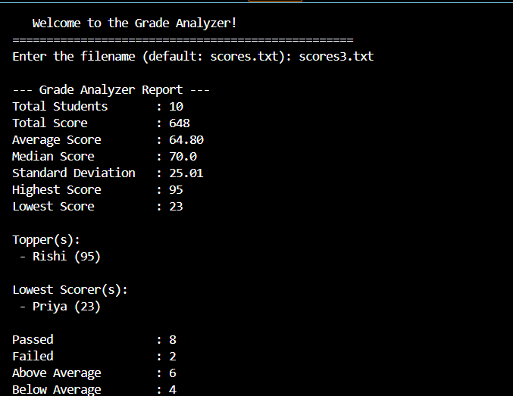
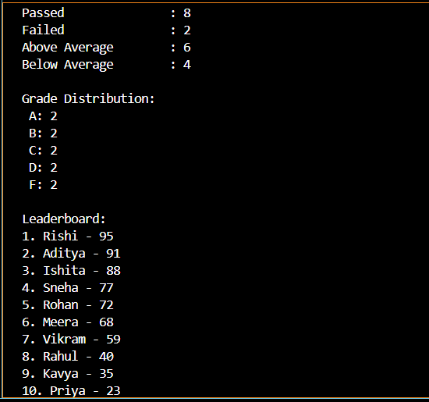
OUTPUT

Slide 13

THANK YOU
- Hariny

